Slide 1
Azure Times #124
June 26, 2024

Slide 2
Networking

Slide 3
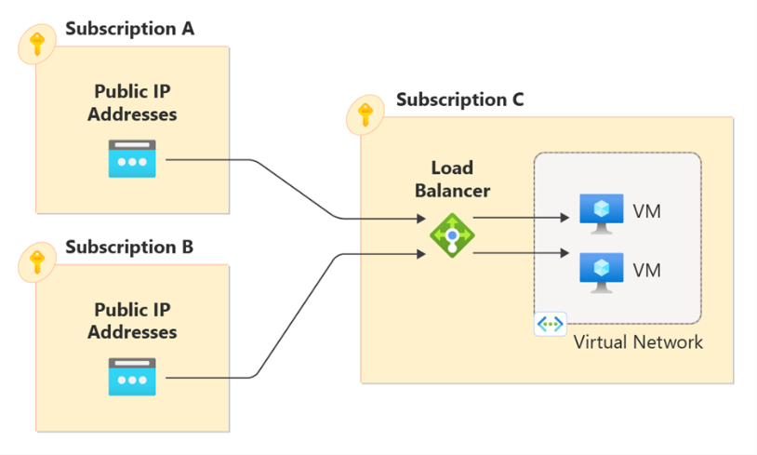
Networking Updates
Cross-subscription Load balancer
Azure Load Balancer supports cross-subscription load balancing, where the frontend IP and/or the backend pool instances can be in a different subscription than the Azure Load Balancer
Cross-subscription frontend IP configurations
Public IP addresses utilized by an Azure Load Balancer can reside in different subscription than the load balancer. If multiple public IP addresses are attached to a load balancer, each IP address can come from a different subscription. An important note is that once a frontend IP configuration is set, its subscription can’t be modified. However, the frontend IP configuration can be updated with a different IP address within the same subscription.
Like public load balancers, internal load balancers can also have cross-subscription frontend IP configurations. In this case, the subnet/virtual network can reside in a different subscription than the load balancer. However, unlike public frontends, all internal frontend configurations must come from the same subnet/virtual network. Furthermore, all backend pools must be configured to the same virtual network as the frontend IP configurations.
Cross-subscription backends allow backend instances to reside in a different subscription other than the load balancer’s subscription. For example, the load balancer could be in subscription 1 and my backend VMs could be located in subscription 2. The backend instances and the virtual network they refer to can be located in a different subscription. Cross-subscription backend pools must utilize a new property known as SyncMode. The SyncMode property is a parameter that can be specified when create a backend pool by using IP addresses and virtual network IDs. This property must be set when using cross-subscription frontends or backends. It has two possible values: “Automatic” or “Manual”. In addition, this property replaces the concept of NIC-based or IP-based backend pools.

Slide 4
Networking Updates
Public preview: Create multiple prefixes for a subnet in an Azure Virtual Network
Large deployments of multiple scale apps within a virtual network are at risk of subnet address space exhaustion. Subnets in virtual networks can host many applications that need the ability to scale out. This feature AllowMultipleAddressPrefixesOnSubnet allows to scale virtual machines and Azure Virtual Machine Scale Sets in subnets with ease. The feature eliminates the need to remove all resources from a subnet as a prerequisite for modifying its address prefixes.
Currently, Virtual Machine Scale Sets allows to specify only one subnet. There isn't capability to extend subnet space or cross subnet boundaries. Virtual Machine Scale Sets can now take advantage of multiple address spaces when scaling up. If the first subnet is full, extra virtual machines spill over to subsequent subnets.
The following limitations apply during the public preview:
The feature only supports virtual machines and virtual machine scale sets and doesn't support Bare Metal or SWIFT resources. Any delegated subnet can't use this feature.
This feature doesn't support multiple customer address (CA) configurations. When using multiple prefixes on a subnet, you're only able to use a single customer address (CA) configuration. A single IPv4 (Internet Protocol version 4) and single IPv6 (Internet Protocol Version 6) address per NIC (network interface card) is supported.

Slide 5
Security & Identity

Slide 6
Security & Identity Updates
SAP Identity Management to Microsoft Entra ID Migration Guidance Now Available
MS announced that guidance for SAP Identity Management (IDM) customers planning to migrate their identity management scenarios to Microsoft Entra is now available. SAP ending maintenance for their identity management solution (SAP IDM) by 2030.

Slide 7
Management & Governance

Slide 8
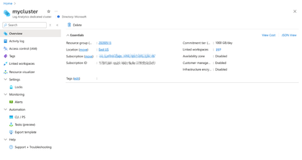
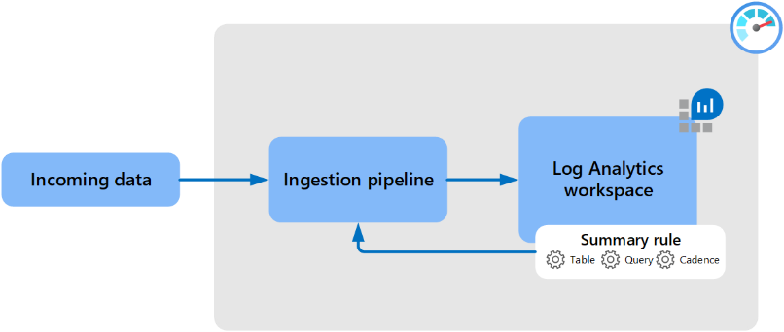
Management & Governance Updates
Generally Available: Azure Monitor, Log Analytics dedicated clusters now supported in Azure portal
It is now possible to create and manage dedicated clusters in Azure portal including cluster create, delete, link and unlink workspaces, change commitment tier and view clusters’ configuration.
Up until now, clusters could be provisioned and managed programmatically using CLI, PowerShell, and REST
Additional experiences such as Customer-managed key configuration are planned next.
Public Preview: Summary rules in Azure Monitor Log Analytics, for optimal consumption experiences and cost
A summary rule lets aggregate log data at a regular cadence and send the aggregated results to a custom log table in Log Analytics workspace.
Summary rules perform batch processing directly in Log Analytics workspace. The summary rule aggregates chunks of data, defined by bin size, based on a KQL query, and reingests the summarized results into a custom table with an Analytics log plan in Log Analytics workspace.
It supports aggregation from any table, regardless of whether the table has an Analytics or Basic data plan. Azure Monitor creates the destination table schema based on the query define. If the destination table already exists, Azure Monitor adds any columns required to support the query results.

Slide 9
Management & Governance Updates
Generally Available: Azure Monitor OpenTelemetry-based Distro adds Live Metrics
Live Metrics is a production-grade capability within Azure Monitor application insights that enables to see telemetry flowing off application with one-second latency.
The Azure Monitor OpenTelemetry “Distro” includes a thin wrapper that enables to get started with a single line of code, and it includes added Azure-specific capabilities such as Live Metrics to give a first-class experience on Azure.
Today’s announcement adds Live Metrics to .NET, Node.js, and Python. The Azure Monitor OpenTelemetry Java Distro already had Live Metrics.
Generally Available: Azure Monitor Log Enablement Policy Expansion
Azure Monitor enables customers to gain end-to-end observability into their applications, infrastructure, and network by collecting, analyzing and acting on telemetry data from their cloud and hybrid environments. Diagnostic settings is a common mechanism by which customers can enable collection of platform logs that Azure makes available on the performance of their Azure resources.
The Azure Monitor team has recently released into general availability (GA) new built-in policies and initiatives for enabling diagnostic settings at scale for all log categories, and updated initiatives for auditing customer interactions with service settings and service data via Azure Policy.
Update records in a Kusto Database (General Availability)
Kusto databases, either in Fabric (KQL Database) or in Azure (Azure Data Explorer), are optimized for append ingestion.
During the public preview, MS introduced two syntaxes: the simplified and expanded syntax. MS only GA the expanded syntax (the most powerful) and are deprecating the simplified syntax. This is due to the simplified syntax being confusing in some scenarios.

Slide 10
Management & Governance Updates
Generally Available: Azure Log Alerts support for Azure Data Explorer
Azure Monitor Alerts allow to monitor Azure and application telemetry to quickly identify issues affecting service. More specifically, Azure Monitor log alert rules allow to set periodic queries on log telemetry to identify potential issues and get notifications or trigger actions.
Until now, log alert rules have supported running queries on Log Analytics and Application Insights data. MS is now introducing support for running queries also on Azure Data Explorer (ADX) tables, and even joining data between those data sources in a single query.
In addition, as part of this newly added support, log alert rules now support managed identities for Azure resources – allowing you to see and control the exact permissions of your log alert rule.
Public Preview: Force detach zone redundant data disks during zone outage
MS announced the public preview support to force detach ZRS data disks from a VM residing on a zone impacted by failure. Customers will now be able to detach the ZRS data disks and attach them to another VM, decreasing the RTO.
Zone-redundant storage (ZRS) synchronously replicates Azure managed disk across three Azure availability zones within the region providing 99.9999999999% (12 9's) of durability over a given year. Zone redundant storage (ZRS) option for Azure managed disks is supported on Premium SSDs and Standard SSDs.

Slide 11
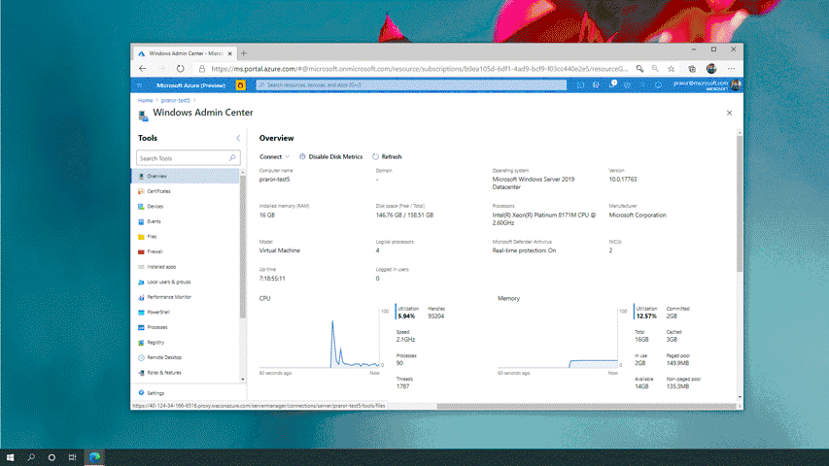
Management & Governance Updates
Announcing Windows Admin Center in Azure for Windows Client machines
MS announced that Windows Admin Center in Azure is expanding to also support Windows 10/11 machines. Windows 10/11 as an Azure VM, will have possibility to be able to managed by Windows Admin Center in Azure to manage client machines directly from the Azure Portal. By default, the Azure Portal provides a singular view for virtual machine management and the essential elements to manage infrastructure.
Announcing the General Availability of Change Actor
Change Analysis allows to identifying who made a change to Azure resources and how the change was made just became easier! With Change Analysis, it is possible now see who initiated the change and with which client that change was made, for changes across all your tenants and subscriptions.
Changes should be available in under five minutes and are queryable for fourteen days. In addition, this support includes the ability to craft charts and pin results to Azure dashboards based on specific change queries.

Slide 12
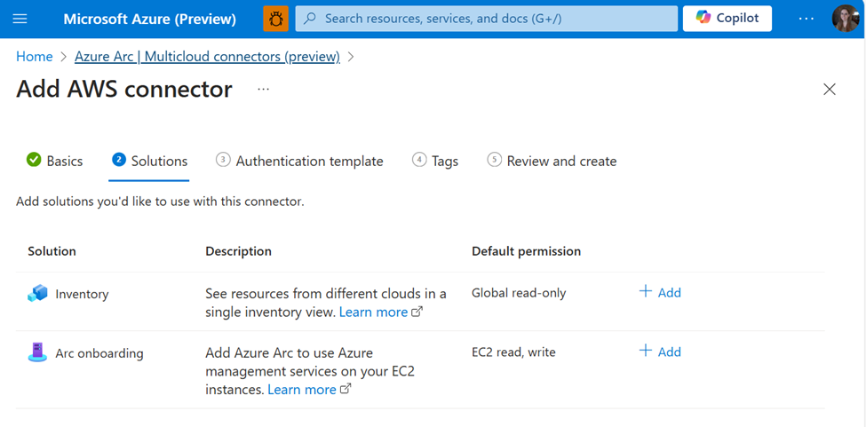
Management & Governance Updates
Announcing enhanced multicloud integration enabled by Azure Arc
MS announced a new set of capabilities for multicloud customers, making it easier than ever to manage cloud resources from a centralized platform. With the adaptive cloud approach enabled by Azure Arc, customers can quickly and easily access and manage their workloads across Azure and AWS through the multicloud connector, which is free to use!
With the multicloud connector, customers can benefit from the following features:
Inventory: Get an up-to-date, comprehensive view of your cloud assets across different cloud providers. Starting with a wide range of AWS services (EC2, S3, Lambda, and more), you can now gain insights into your Azure & AWS environments in a single pane of glass. The agentless inventory solution will periodically scan your AWS environment, project the discovered resources in AWS as Azure resources, including all of the AWS metadata like AWS tags. Now, you can easily view, query, and tag these resources from a centralized location.
Azure Arc onboarding: Automatically Arc-enable your existing and future EC2 instances so you can leverage Azure and Microsoft services, like Azure Monitor and Microsoft Defender. Through the multicloud connector, the Azure Arc agent will be automatically installed for machines that meet the pre-requisites.

Slide 13
Compute

Slide 14
Compute Updates
Public Preview: Announcing Foundation Model Training
With Foundation Model Training, Azure Databricks users can use their own data to customize a foundation model to optimize performance for their specific application.
By fine-tuning or continuing training of a foundation model, organizations can train their own model using significantly less data, time, and compute resources versus training a model from scratch.
Azure Databricks users have everything in a single platform: their own data to use for training, the foundation model to train, checkpoints saved to MLflow, and the model registered in Unity Catalog ready to deploy.
Public Preview: Upgrade Policies for Virtual Machine Scale Sets with Flexible Orchestration
The upgrade policies available for Virtual Machine Scale Sets are Automatic, Manual, and Rolling. The upgrade policy choose can impact the overall service uptime of Virtual Machine Scale Set.
The upgrade policies available for Virtual Machine Scale Sets are Automatic, Manual and Rolling.
Automatic upgrade policy - with an automatic upgrade policy, the scale set makes no guarantees about the order of virtual machines being brought down. The scale set might take down all virtual machines at the same time to perform upgrades.
Manual upgrade policy - with a manual upgrade policy, choose when to update the scale set instances. Nothing happens automatically to the existing virtual machines when changes occur to the scale set model. New instances that are added to the scale set, utilize the most update to date models available.
Rolling Upgrade Policy + MaxSurge - with a rolling upgrade policy, the scale set performs updates in batches. There is also more control over the upgrades with settings like batch size, max healthy percentage, prioritizing unhealthy instances and enabling upgrades across availability zones. Additionally, you can enable MaxSurge which will create new virtual machines to replace virtual machines running in the old model. Using MaxSurge ensures scale set does not see any reduced capacity during an upgrade.

Slide 15
Compute Updates
Generally Available: az command invoke in AKS
AKS run command allows users to remotely invoke commands in an AKS cluster through the AKS API. For example, this feature introduces a new API that supports executing just-in-time commands from a remote laptop for a private cluster. This can greatly assist with quick just-in-time access to a private cluster when the client is not on the cluster private network, while still retaining and enforcing full RBAC controls and private API server.
Generally Available: OS Security Patch channel for Linux in AKS
OS security patch channel for Linux, part of NodeOSUpgrade feature, is now generally available.
OS security patches are AKS-tested, fully managed, and applied with safe deployment practices. AKS regularly updates the node's virtual hard disk (VHD) with patches from the image maintainer labeled "security only."
This channel is part of nodeosupgrade feature, honors maintenance windows and limits disruption by applying live patching wherever necessary.
Available: Announcing kube-egress-gateway for Kubernetes
kube-egress-gateway is an open-source project that offers a scalable and cost-efficient solution for configuring fixed source IPs for Kubernetes pod egress traffic on Azure. The kube-egress-gateway components run within Kubernetes clusters—whether managed (Azure Kubernetes Service, AKS) or unmanaged—and use one or more dedicated Kubernetes nodes as pod egress gateways, routing pod outbound traffic through a WireGuard tunnel.
Compared to existing methods, such as creating dedicated Kubernetes nodes with a NAT gateway or assigning instance-level public IP addresses and scheduling only specific pods on these nodes, kube-egress-gateway is more cost-efficient. It allows pods requiring different egress IPs to share the same gateway and be scheduled on any regular worker node.
Public Preview: Cluster operation status for AKS
Cluster operation status for AKS is now in public preview. With this feature, it is possible to get a snapshot of progress for long standing operations such as upgrade, scale, create.

Slide 16
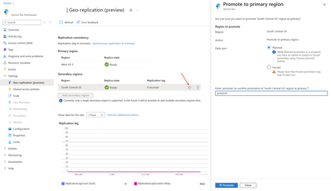
Compute Updates
Public Preview: Geo-Replication for Azure Service Bus Premium
MS announced the public preview of the new Geo-Replication feature for Azure Service Bus in the premium tier. This feature ensures that the metadata and data of a namespace are continuously replicated from a primary region to a secondary region. Moreover, this feature allows promoting a secondary region at any time. The Geo-Replication feature is the latest option to insulate Azure Service Bus applications against outages and disasters.
The Geo-Replication feature implements metadata and data replication in a primary-secondary replication model. It works with a single namespace, and at a given time there’s only one primary region, which serves both producers and consumers. There is a single hostname used to connect to the namespace, which always points to the current primary region.
After promoting a secondary region, the hostname points to the new primary region, and the old primary region is demoted to secondary region. After the new secondary has been re-initialized, it is possible to promote this region again to primary at any moment.

Slide 17
Compute Updates
Public Preview: Azure Container Apps available in Azure Government Cloud Virginia
Azure Container Apps, a managed serverless container service, is now available in Azure Government Cloud. Azure Container Apps offers an ideal platform for application developers who want to run apps and microservices in containers without managing infrastructure. Azure Container Apps is built on a foundation of powerful open-source technology including Kubernetes, KEDA, Dapr, and Envoy.
Public Preview: Windows Server 2025 now available
Windows Server 2025 delivers advanced security, new Azure hybrid features, a high-performance platform for existing apps and AI workloads, and a modernized Windows Server experience. With this new release you will see investments in:
A rich set of security innovations including new capabilities in Active Directory, Server Message Block (SMB) improvements including SMB over QUIC, and security updates with fewer reboots.
Improved hybrid capabilities like Software-defined network (SDN) multisite features allowing native L2 and L3 connectivity for workloads in multiple locations, flexible hybrid and multicloud management tools, and easier onboarding to Azure Arc.
New features for AI, performance, and scale such as GPU partitioning across virtual machines, vastly improved Hyper-V performance and scalability, and easy upgrades through Windows Update to name a few.
Generally Available: Spain Central region added to Azure HDInsight
HDInsight is now generally available in Spain Central. Azure HDInsight is a managed, full-spectrum, open-source analytics service in the cloud for enterprises. It is now possible to use open-source frameworks such as Hadoop, Apache Spark, Apache Hive, LLAP, Apache Kafka, and more.

Slide 18
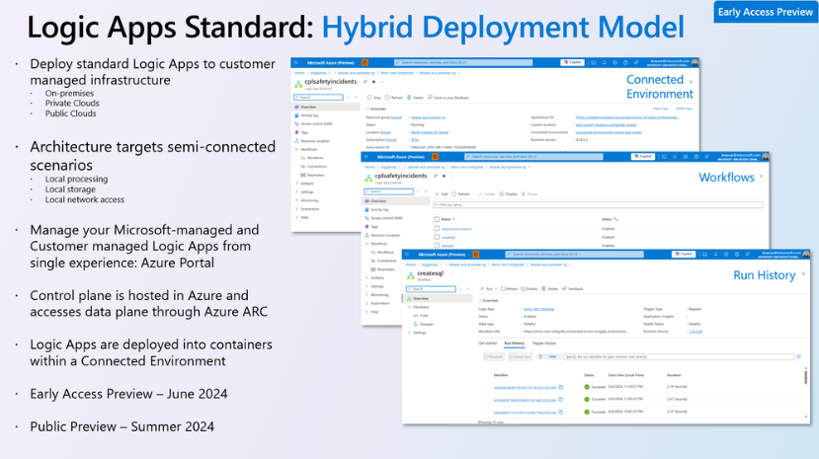
Compute Updates
Logic Apps Standard - New Hybrid Deployment Model (Preview)
A new Hybrid Deployment Model for Azure Logic Apps (Standard) allows to run Logic Apps workloads on customer managed infrastructure. This new capability is currently in an early access preview.
The new hybrid deployment model is ideal for customers who want more control over where and how their integration workloads are hosted. This includes on-premises, private clouds or public clouds. This offering focuses on semi-connected scenarios that offer local processing, local storage and local network access. Using this model allows customers to absorb intermittent internet connectivity issues

Slide 19
Databases

Slide 20
Databases Updates
Public Preview: Azure Cosmos DB continuous backup for accounts using Azure Synapse Link
Continuous backup is now in public preview for Azure Cosmos DB accounts using Azure Synapse Link. Migrate to continuous backup to optimize costs and unlock point-in-time restores. This also enables to use Fabric mirroring, for advanced analytics on Microsoft Fabric.
General Availability: vCore-based Azure Cosmos DB for MongoDB now supports Mongo Ver 7.0
vCore-based Azure Cosmos DB for MongoDB has expanded its capabilities and now supports MongoDB Version 7.0.
General availability: Database compatibility level 160 in Azure SQL Database
Database compatibility level 160 is now the default for new databases created in Azure SQL Database across almost all public regions.
The alignment of SQL versions to default compatibility levels are as follows:
100: in SQL Server 2008 and Azure SQL Database
110: in SQL Server 2012 and Azure SQL Database
120: in SQL Server 2014 and Azure SQL Database
130: in SQL Server 2016 and Azure SQL Database
140: in SQL Server 2017 and Azure SQL Database
150: in SQL Server 2019 and Azure SQL Database
160: in SQL Server 2022 and Azure SQL Database

Slide 21
Databases Updates
Generally Available: Azure SQL updates for late June 2024
In late June 2024, the following updates and enhancements were made to Azure SQL:
Prepare for planned maintenance events on your Azure SQL Managed Instance resources by enabling advance notifications.
Enable zone redundancy for Azure SQL Database Hyperscale's named replicas to enhance protection against extensive failures, such as datacenter disasters, without altering application logic.
Public Preview: Redis 7.2 on Azure Cache for Redis Enterprise
Enterprise and Enterprise Flash tier caches now support Redis 7.2 in preview. This latest version of Redis offers over a dozen new commands and performance enhancements over Redis 6.0, the previous version offered on Azure Cache for Redis. New features include expanded geospatial functionality, sharded pub/sub, and support for the RESP3 protocol.

Slide 22
Databases Updates
Generally Available: IOPS scaling for Azure Database for PostgreSQL - Flexible Server
MS announced the general availability of IOPS scaling for Azure Database for PostgreSQL - Flexible Server. This feature empowers to dynamically scale IOPS based on workload needs. Ensure optimal performance during high-demand operations like migrations or data loads and scale down to save costs when demand decreases. With IOPS scaling, it is possible to fine-tune database's performance and manage costs more effectively without over-provisioning resources. Experience seamless and efficient database management with the flexibility to adjust IOPS as required. Start using IOPS scaling today to enhance your database's performance and efficiency.
Generally Available: New Azure Advisor recommendations for Azure Database for PostgreSQL - Flexible Server
New Azure Advisor recommendations have been created for Azure Database for PostgreSQL - Flexible Server and existing recommendations have been improved to provide more actionable guidance.
Azure Advisor is a cloud assistant that analyzes your configuration and usage telemetry to make personalized recommendations to help improve performance, reliability, security, and cost effectiveness. You can find these recommendations in the Advisor dashboard section of the Azure Portal.
New Azure Database for PostgreSQL - Flexible Server recommendations include checks for long running and orphaned prepared transactions, crossing the transaction wraparound limit, and exceeding the recommended bloat ratio.

Slide 23
Databases Updates
Public Preview: Extension version sync for Azure Database for PostgreSQL - Flexible Server
MS announced the public preview of extension version sync for Azure Database for PostgreSQL – Flexible Server. This feature allows to seamlessly update PostgreSQL extensions to the latest versions with a simple command, ensuring system remains secure and up to date.
By using `ALTER EXTENSION <extension-name> UPDATE`, it is possible to automatically upgrade to the most stable and secure versions available, enhancing both security and operational stability with minimal effort. This streamlined process prevents unauthorized changes and potential vulnerabilities, making it easier for you to manage your database extensions efficiently.
Public Preview: Online migration in migration service Azure Database for PostgreSQL
MS announced the launch of latest migration service in Azure Database for PostgreSQL feature: online migration, now available in public preview. This feature empowers to migrate PostgreSQL databases to Azure seamlessly and with minimal downtime.
By leveraging this new feature, it is possible to confidently move workloads to a more robust and reliable cloud environment, positioning your business for future growth. Start your migration journey today and experience the advantages of Azure Database for PostgreSQL with our migration service.

Slide 24
ML & AI & IOT

Slide 25
ML & AI & IOT Updates
What's new in Azure AI Translator
MS announced new releases and enhancements to Azure AI Translator Service: new endpoint which unifies document translation async batch and sync operation and the SDKs are updated.
Asynchronous batch translation supports the processing of multiple documents and large files. The batch translation processes source documents from an Azure Blob storage and uploads translated documents back into it.
Updated SDK - the updated document translation SDK supports both asynchronous batch operation and synchronous operation.
Ready to use solution in Azure AI Studio - Customers can easily build apps for their document translation needs using the SDK. One such example is the document translation tool in the Azure AI Studio.
SharePoint document translation - the document translation integration in SharePoint lets you easily translate a selected file or a set of files into a SharePoint document library. This feature lets you translate files of different types either manually or automatically by creating a rule.
Document translation in container is generally available - In addition to the above updates, earlier this year, we announced the release of document translation and transliteration features for Azure AI Translator containers as preview. Today, both capabilities are generally available. All Translator container customers will get these new features automatically as part of the update.

Slide 26
DevOps & IaC & Automation

Slide 27
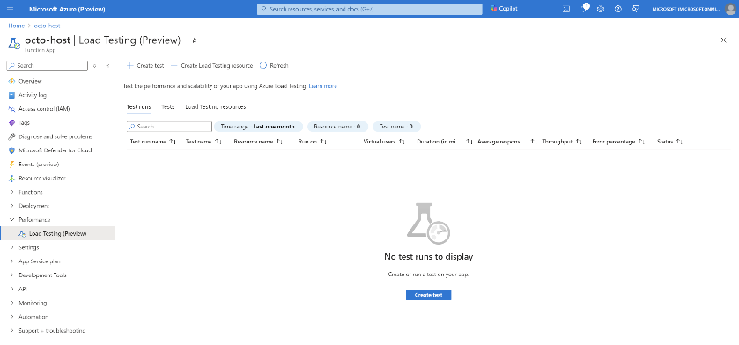
DevOps & IaC & Automation
Generally Available: Run Azure Load Testing on Azure Functions
It is now possible to create and run load tests directly from Azure Functions in Azure portal. Load test functions by simply selecting the function, key and specifying request parameters and load configuration. You will automatically gain access to client-side and Functions metrics, which will help in identifying performance bottlenecks.

Slide 28
Miscellaneous

Slide 29
Miscellaneous Updates
Azure Communication Services May 2024 Feature Updates
Data Retention with Chat threads - Developers can now create chat threads with a retention policy between 30 and 90 days. This feature is in public preview. This policy is optional – a developer can choose to create a chat thread with infinite retention (as always) or set a retention policy between 30 and 90 days. If the thread needs to be kept for longer than 90 days, you can extend the time using the update chat thread property API. The policy is geared for data management in organizations that have a need to move data into their archives for historical purposes or delete the data within a given period.
PowerPoint Live - Now in general availability, PPT Live gives both the presenter and audience an inclusive and engaging experience, combining the best parts of presenting in PowerPoint with the connection and collaboration of a Microsoft Teams meeting.
Live Reactions - We have new APIs for end-users to react with emojis during the meeting: like, love, applause, laugh, surprise.
Closed Captions - Promote accessibility by displaying text of the audio in video calls. Already available for app-to-Teams calls, this general availability release adds support for closed captions in all app-to-app calls.
Copilot for Call Diagnostics - AI can help app developers across every step of the development lifecycle: designing, building, and operating. Developers with Microsoft Copilot for Azure (public preview) can use Copilot within Call Diagnostics to understand and resolve a variety of calling issues.

Slide 30
Miscellaneous Updates
End of Support: Azure support plan offer being discontinued on June 30, 2024.
The existing Azure Support offer is being discontinued on June 30, 2024. Beginning July 1, 2024, all customers who do not already have a paid support plan (Microsoft Unified, ProDirect support, etc.) will need to purchase a support plan if they wish to maintain technical support coverage.
Customers will retain access to the subscription management and billing support services available to all Azure customers at no charge.
Customers wishing to transact support on their Enterprise Agreement should contact their Microsoft representative or partner.
Customers wishing to transact support on their Microsoft Customer Agreement, can purchase support online in the Azure Portal.

Slide 31
Information

Slide 32
Information
Azure Times GitHub Repo

Slide 33
Questions

